Slide 1



Check in khóa học
Bước 1: Kết nối wifi/3G
Bước 2: Quét QR code
Bước 3: Điền thông tin và submit
CHECK IN

Slide 2
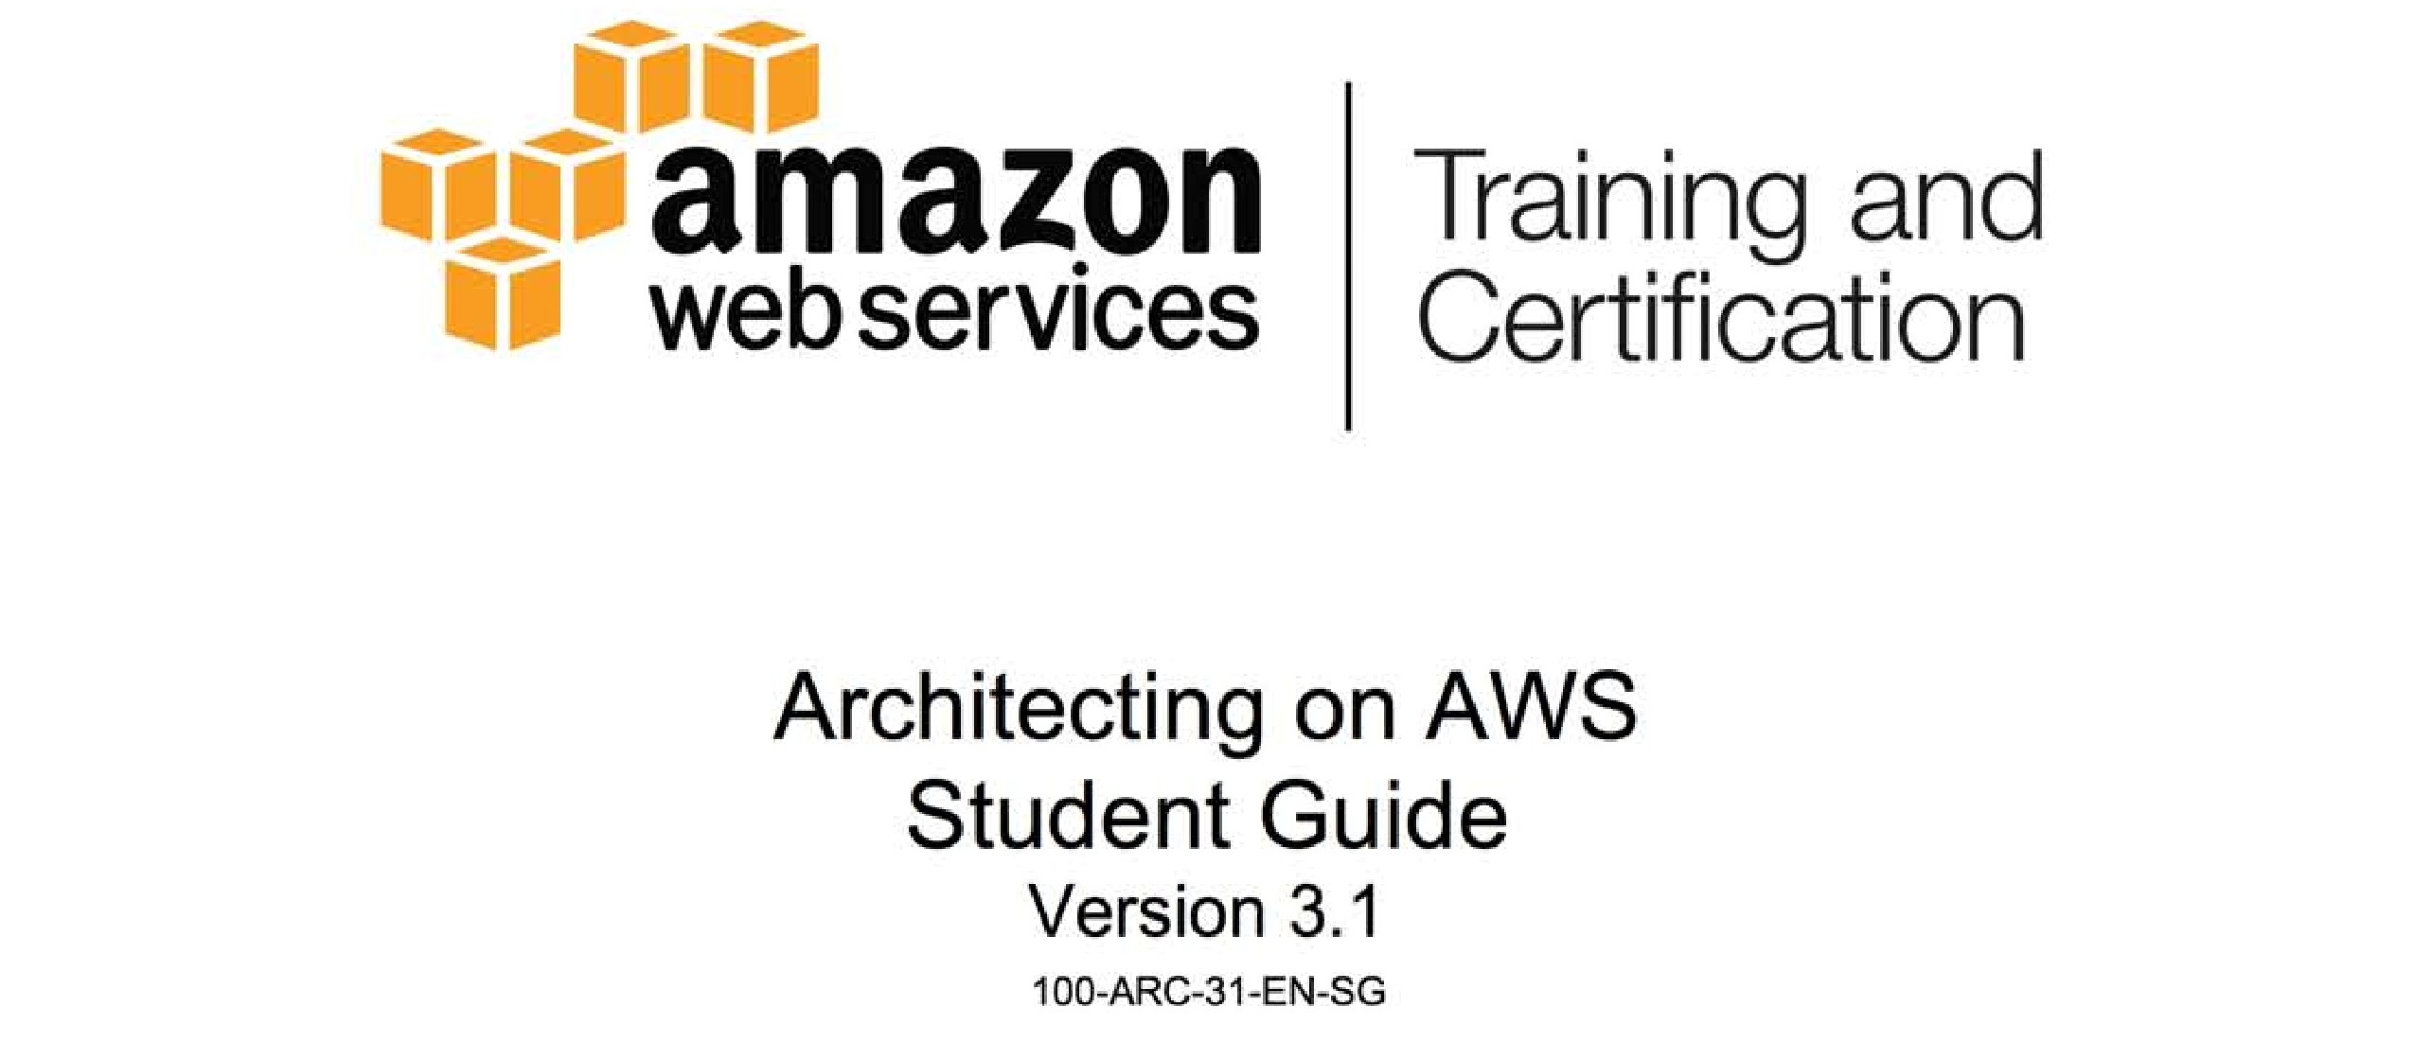

Slide 3

Module 7: Elasticity, Scalability, and Bootstrapping

Slide 4
Topics
Basic tenets of AWS
Patterns and (anti-patterns) for creating scalable architectures in AWS
EC2 Instances
Components of Auto Scaling

Slide 5
Topics
Basic tenets of AWS
Review how traditional architectures accommodate expected load variation
Anti-patterns for elastic, scalable architectures
4 patterns for elastic, scalable architectures
Patterns and (anti-patterns) for creating scalable architectures in AWS
EC2 Instances
Components of Auto Scaling

Slide 6
Expected Load Variation
Non-cloud systems typically over-provision and under-utilize
Under-utilization costs:
Capital
Space
Power
Cooling
Maintenance

Slide 7
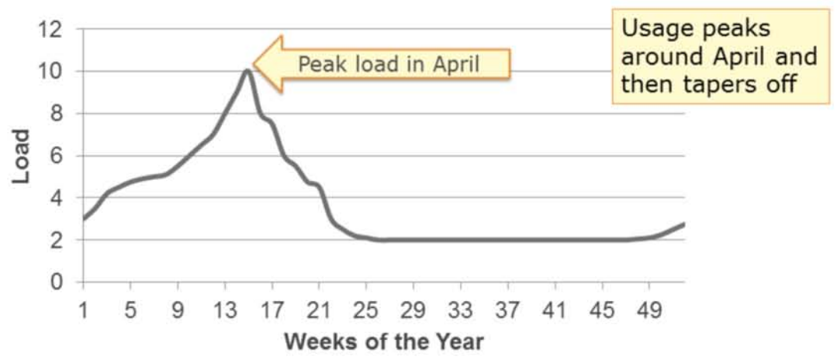
Expected Load Variation Example (1 of 6)

Slide 8
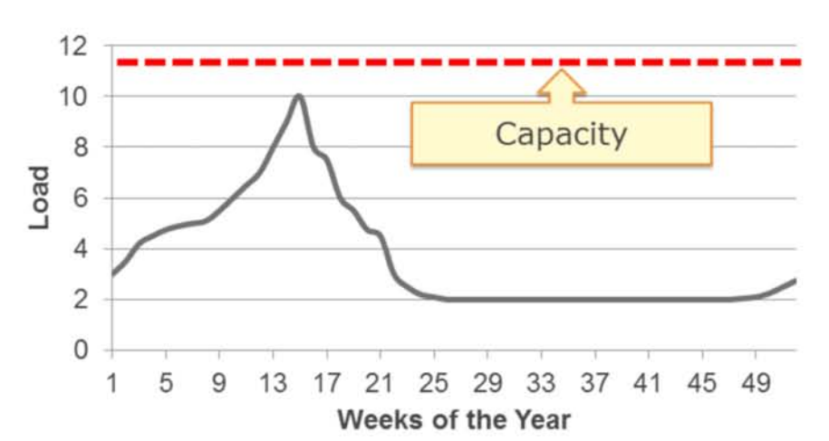
Expected Load Variation Example (2 of 6)

Slide 9
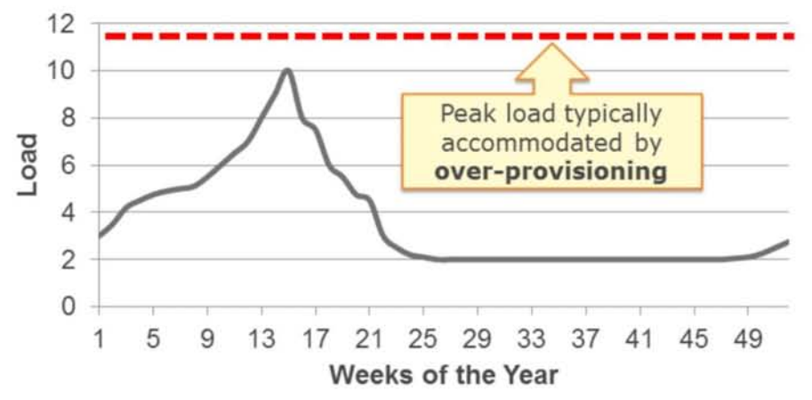
Expected Load Variation Example (3 of 6)

Slide 10
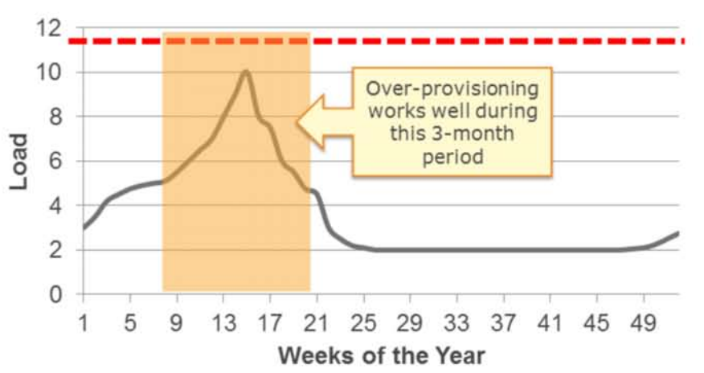
Expected Load Variation Example (4 of 6)

Slide 11
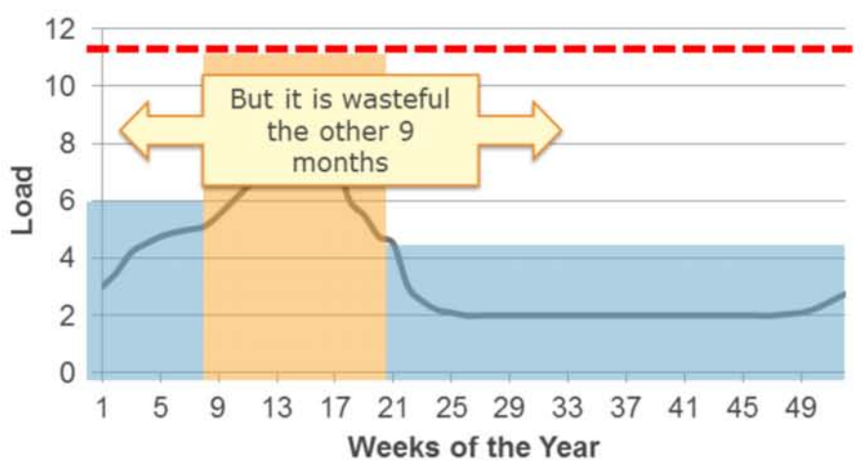
Expected Load Variation Example (5 of 6)

Slide 12
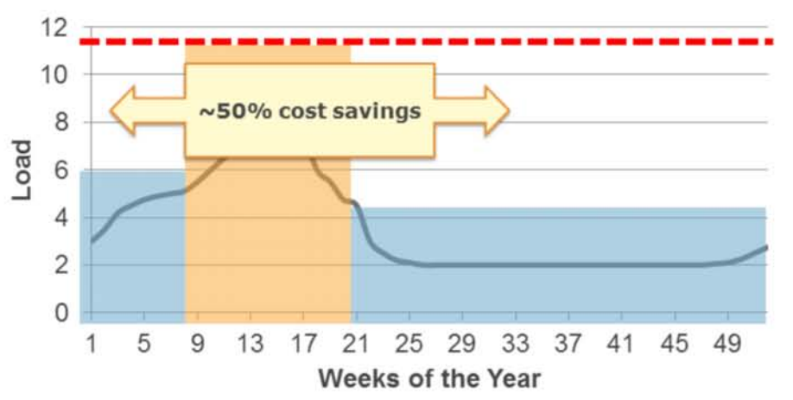
Expected Load Variation Example (6 of 6)

Slide 13
Elastic environments
Highly utilized all the time
Provision resources “just in time”

Slide 14
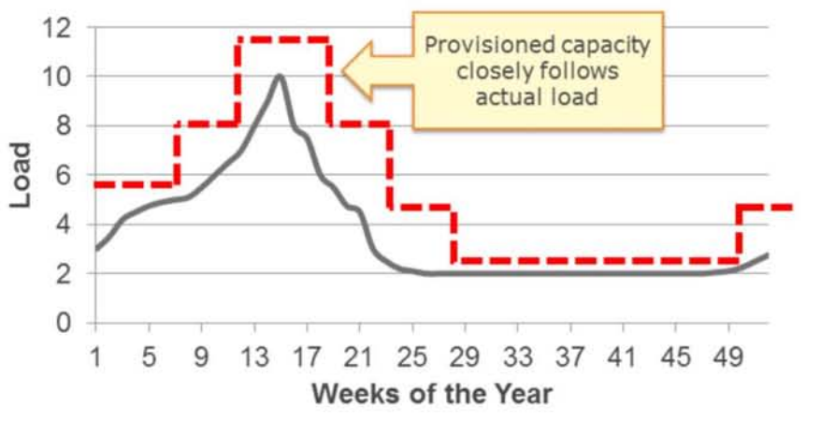
Elastic environments scenario (1 of 4)

Slide 15
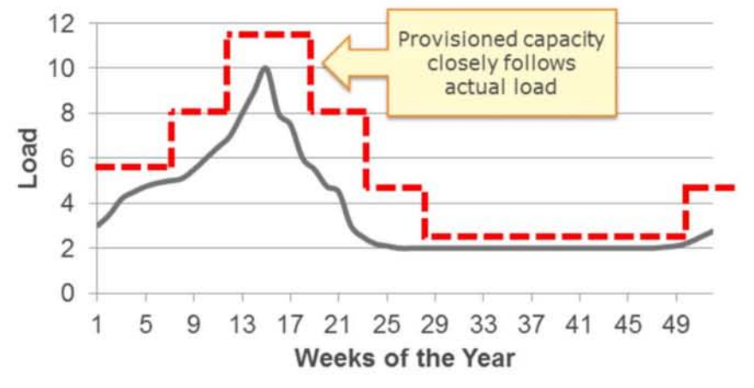
Elastic environments scenario (2 of 4)

Slide 16
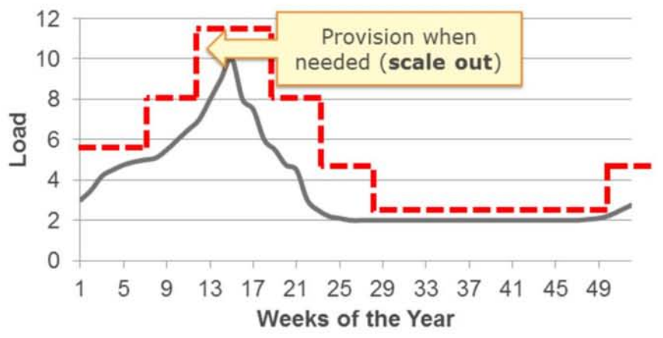
Elastic environments scenario (3 of 4)

Slide 17
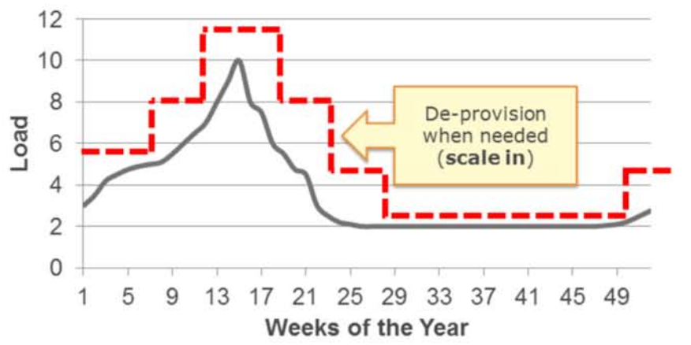
Elastic environments scenario (4 of 4)

Slide 18
Topics
Basic tenets of AWS
Patterns and (anti-patterns) for creating scalable architectures in AWS
EC2 Instances
Components of Auto Scaling

Slide 19
Patterns and anti-patterns
Anti-Pattern: Manual Processes
When direct, manual intervention is required to start new resources – or scale existing one – will be a blocker at scale
Pattern: Automated Processes

Slide 20
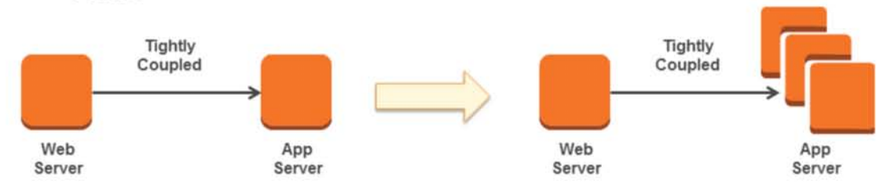
Patterns and anti-patterns: Integration
Anti-Pattern: Tightly-coupled
Applications components in which a single unit depends on another specific single unit behave poorly when the dependency fails or needs to subdivide (for example, grow horizontally) to scale

Slide 21
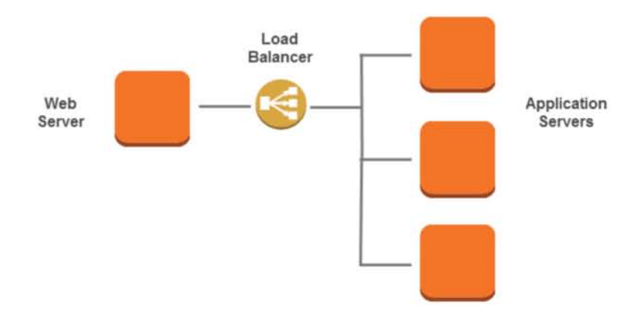
Patterns and anti-patterns: Integration (continue)
Pattern: Loosely-coupled

Slide 22
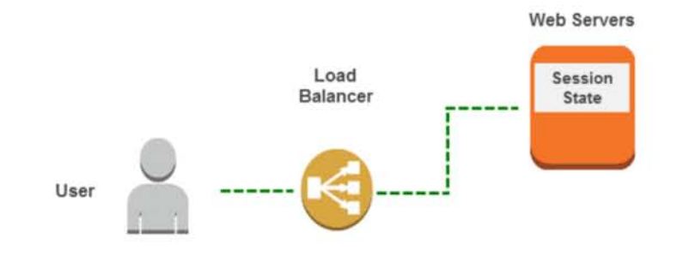
Patterns and anti-patterns: Session state
Anti-Pattern: Stateful
Applications that store state on one instance are more challenging to scale horizontally

Slide 23
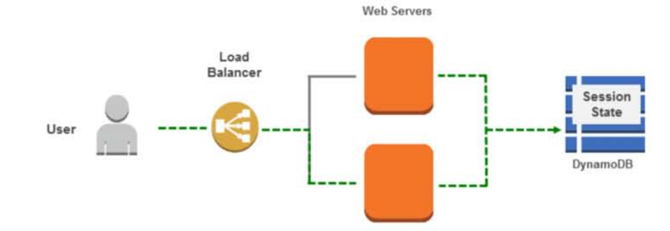
Patterns and anti-patterns: Session state (continue)
Pattern: Stateless
Move state to a shared, accessible location

Slide 24
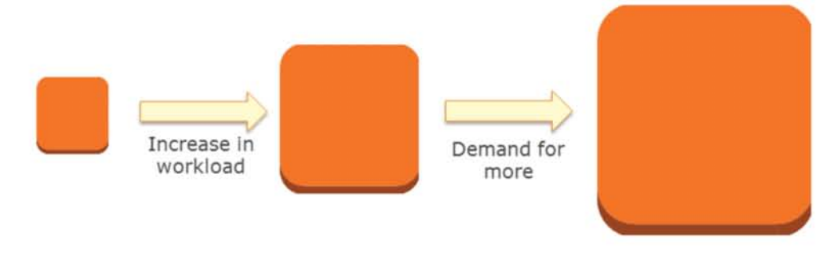
Patterns and anti-patterns
Anti-Pattern: Vertical
Vertical scaling (more CPU, memory, and so on) will eventually run out of room

Slide 25
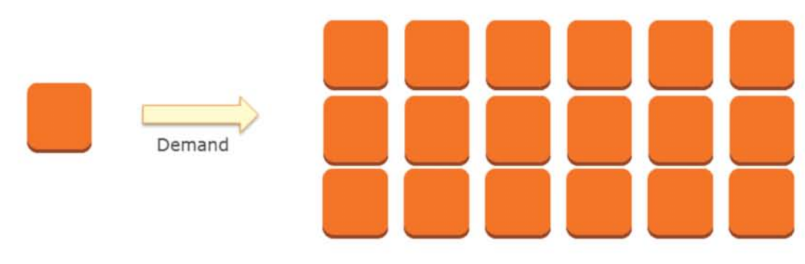
Patterns and anti-patterns
Pattern: Horizontal
Add and remove instances as needed

Slide 26
Topics
Basic tenets of AWS
Patterns and (anti-patterns) for creating scalable architectures in AWS
EC2 Instances
Components of Auto Scaling

Slide 27
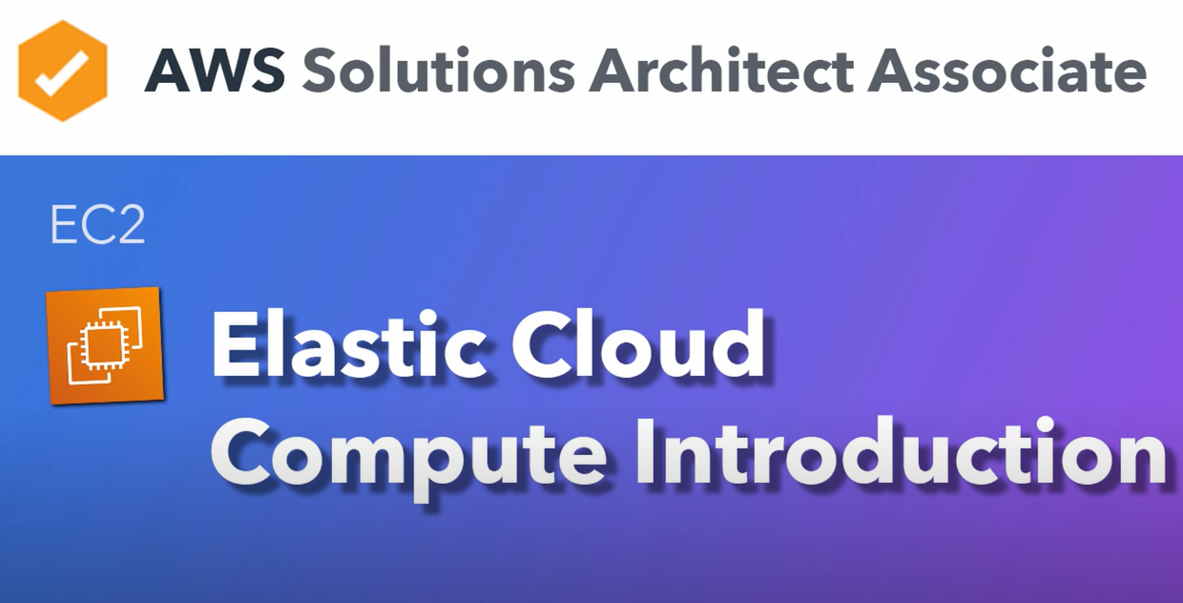

Slide 28
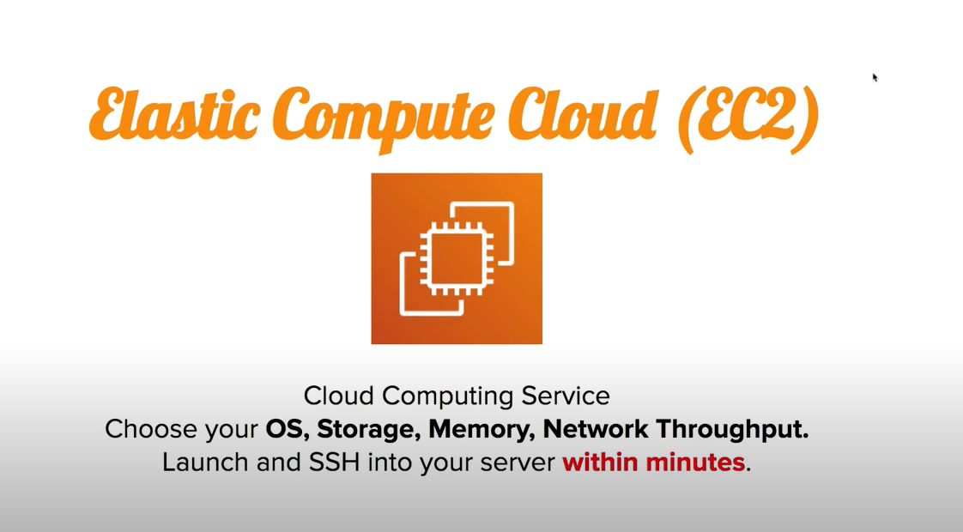

Slide 29
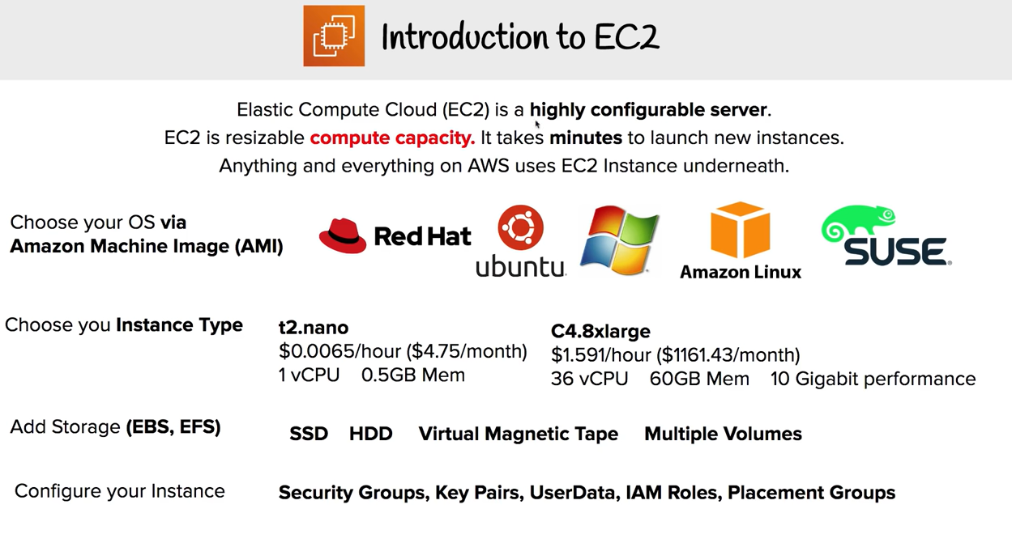

Slide 30
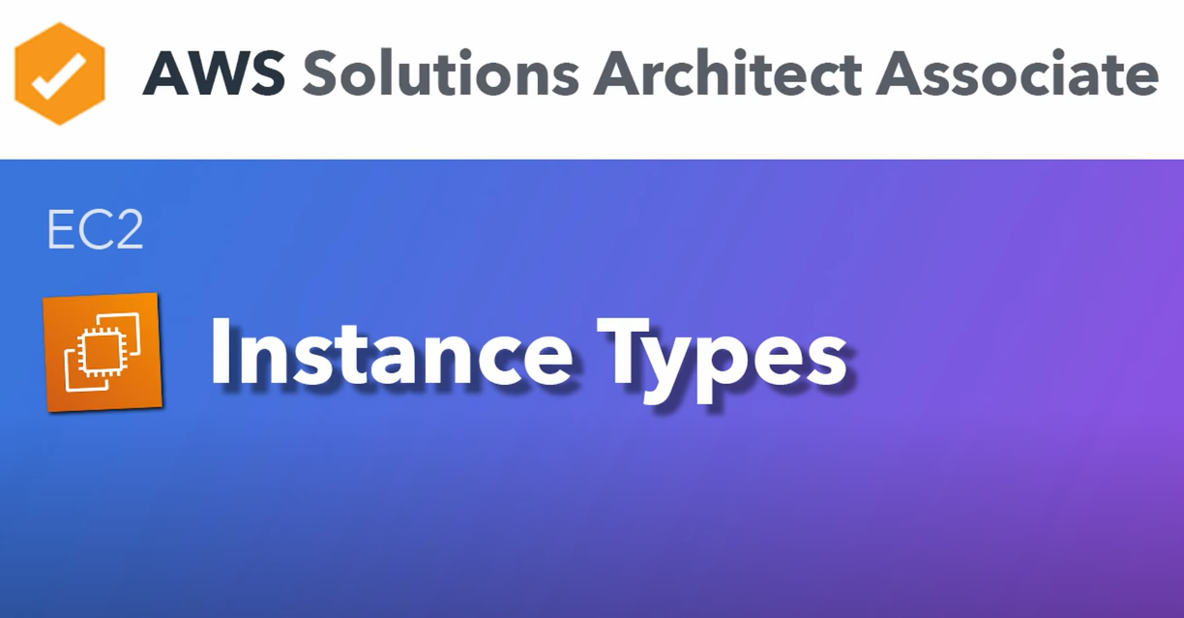

Slide 31
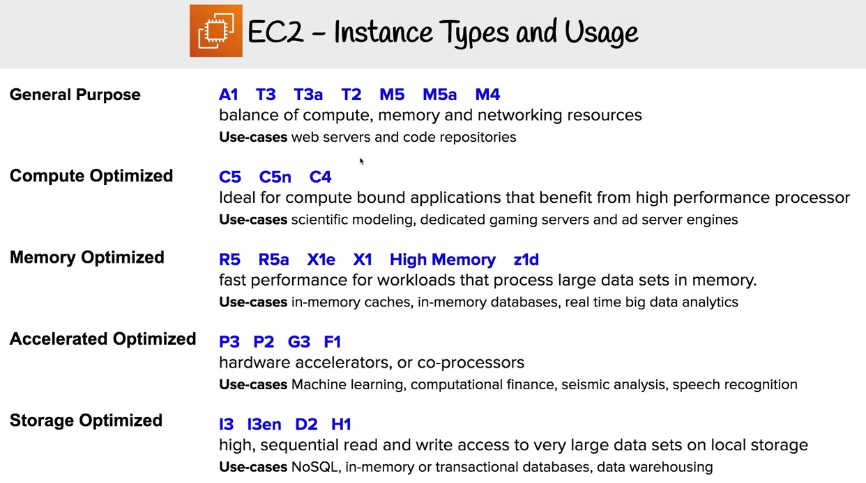

Slide 32
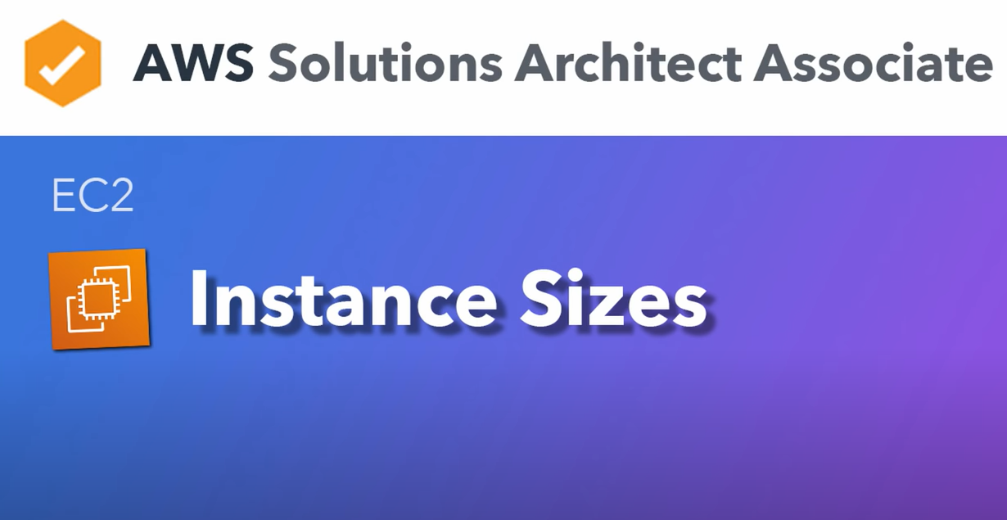

Slide 33
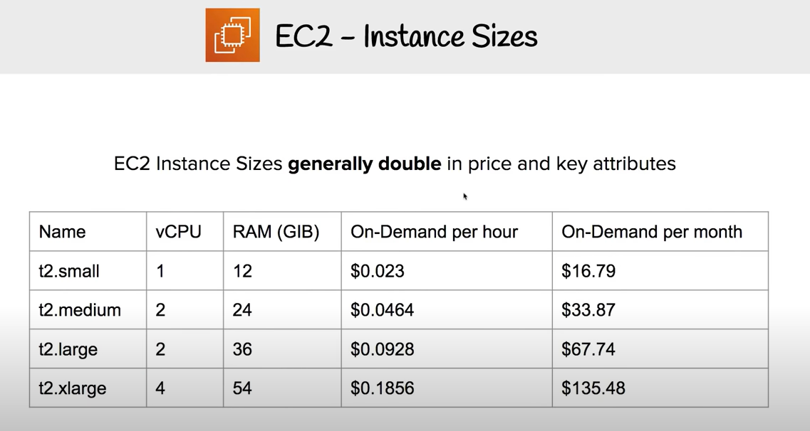

Slide 34


Slide 35
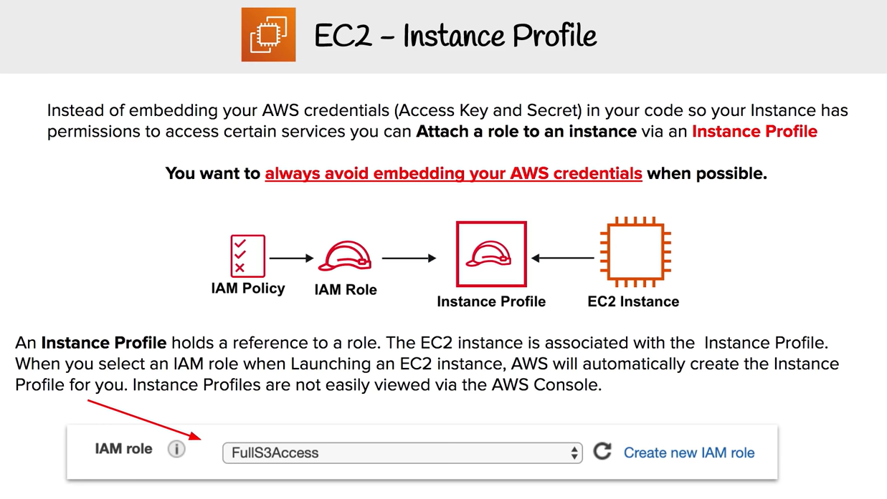

Slide 36
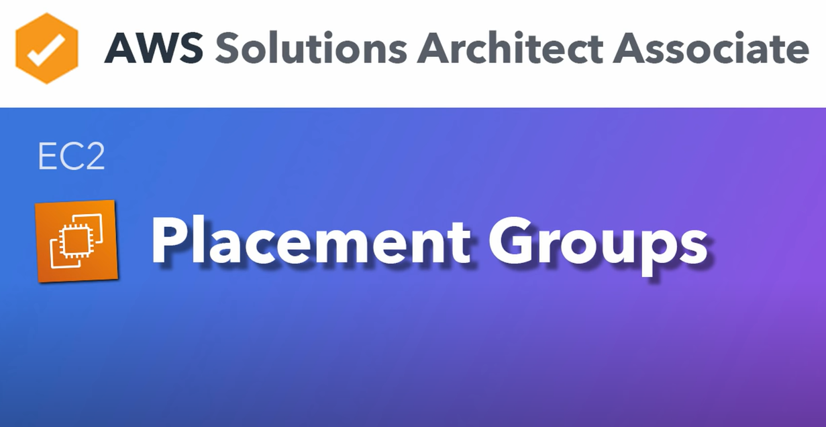

Slide 37
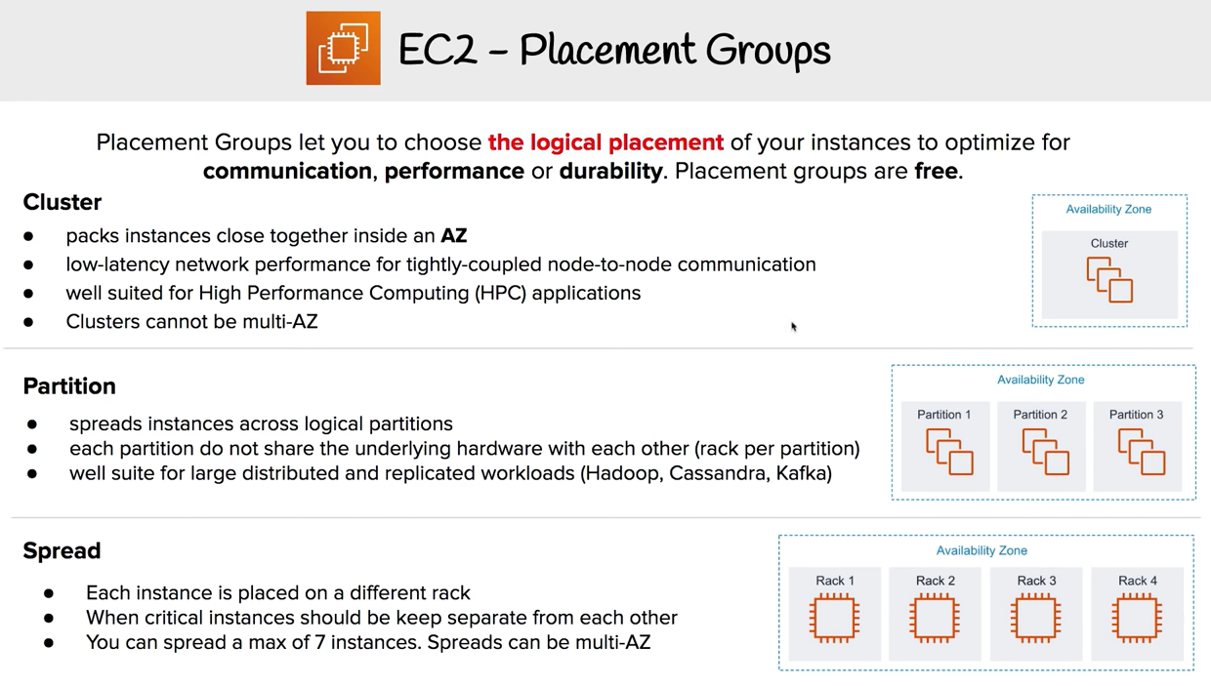

Slide 38
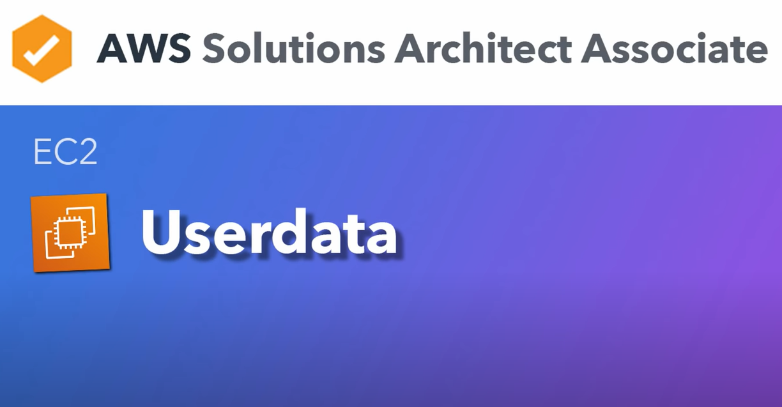

Slide 39
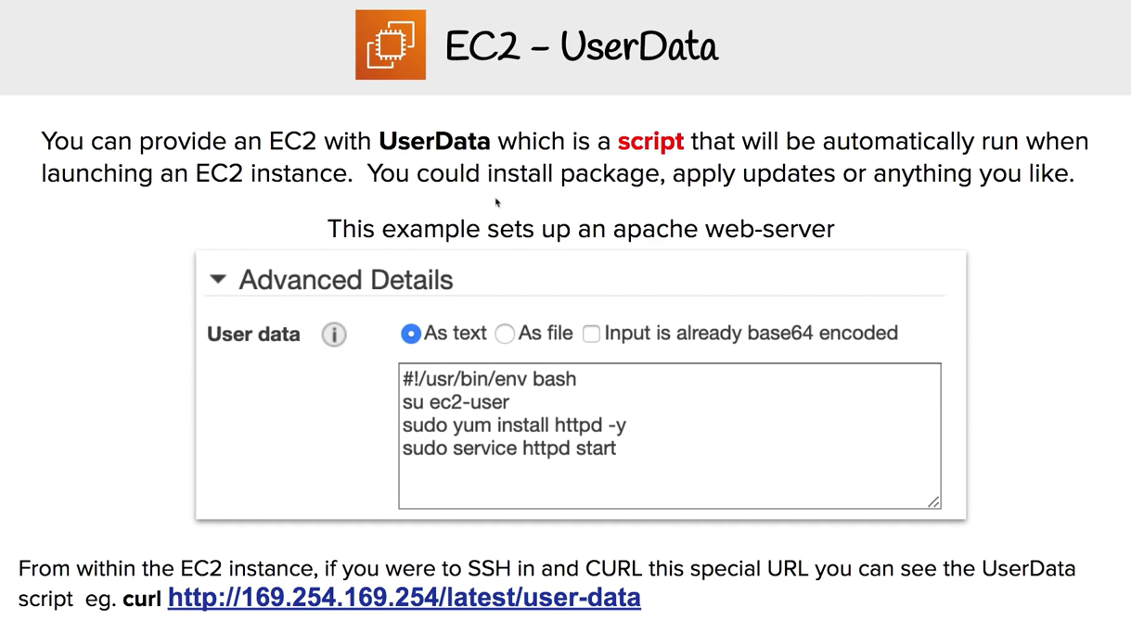

Slide 40


Slide 41
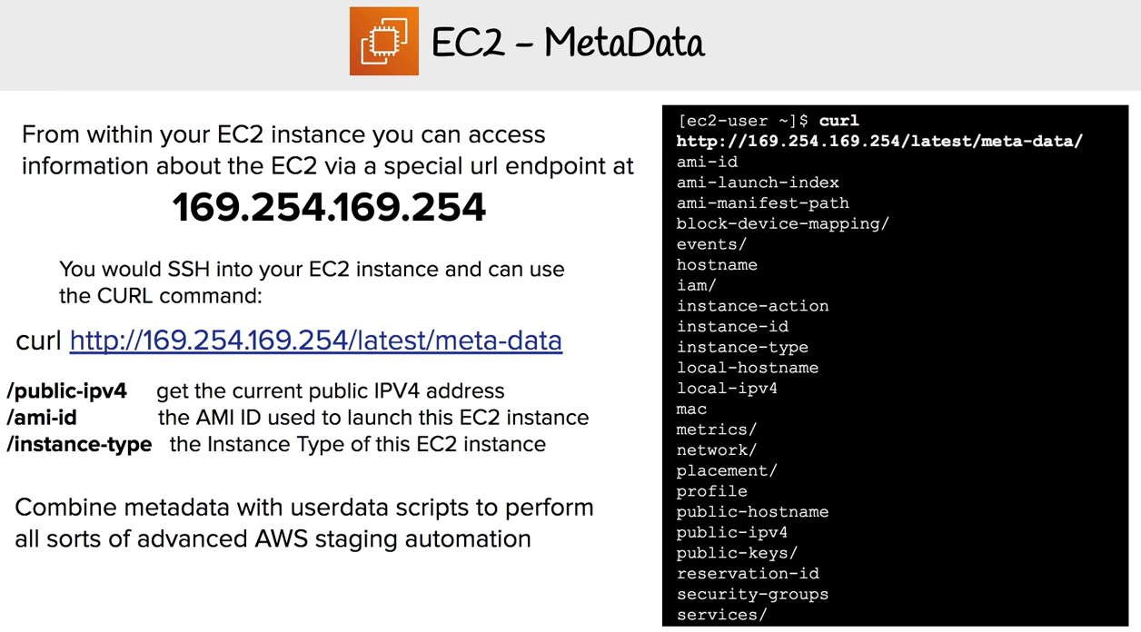

Slide 42
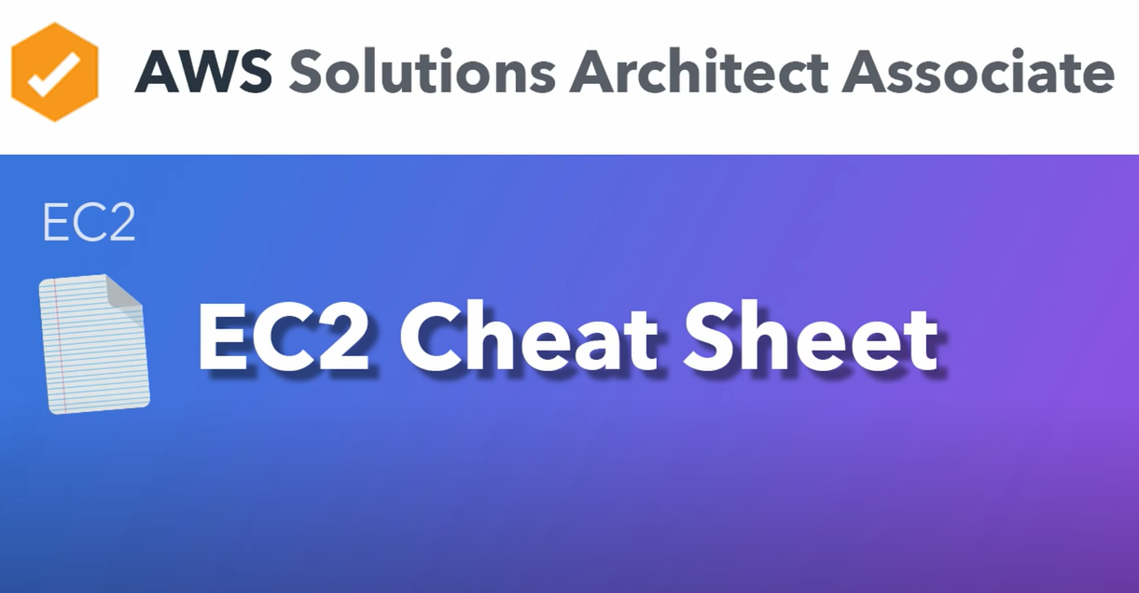

Slide 43
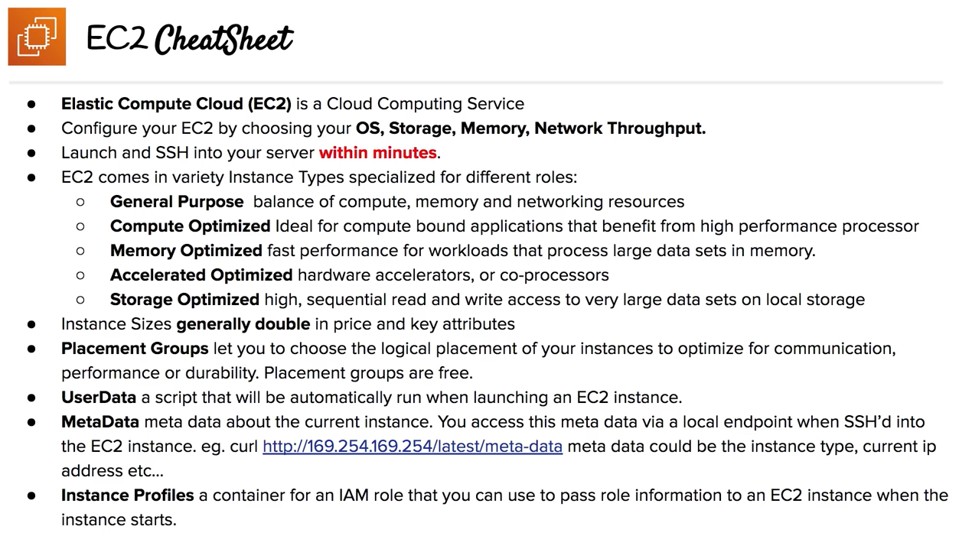

Slide 44
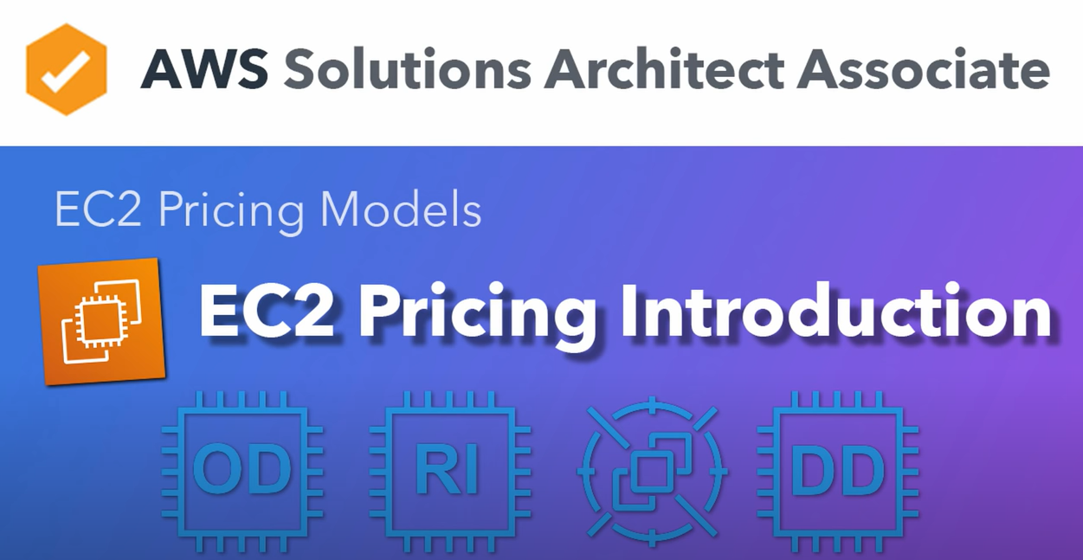

Slide 45
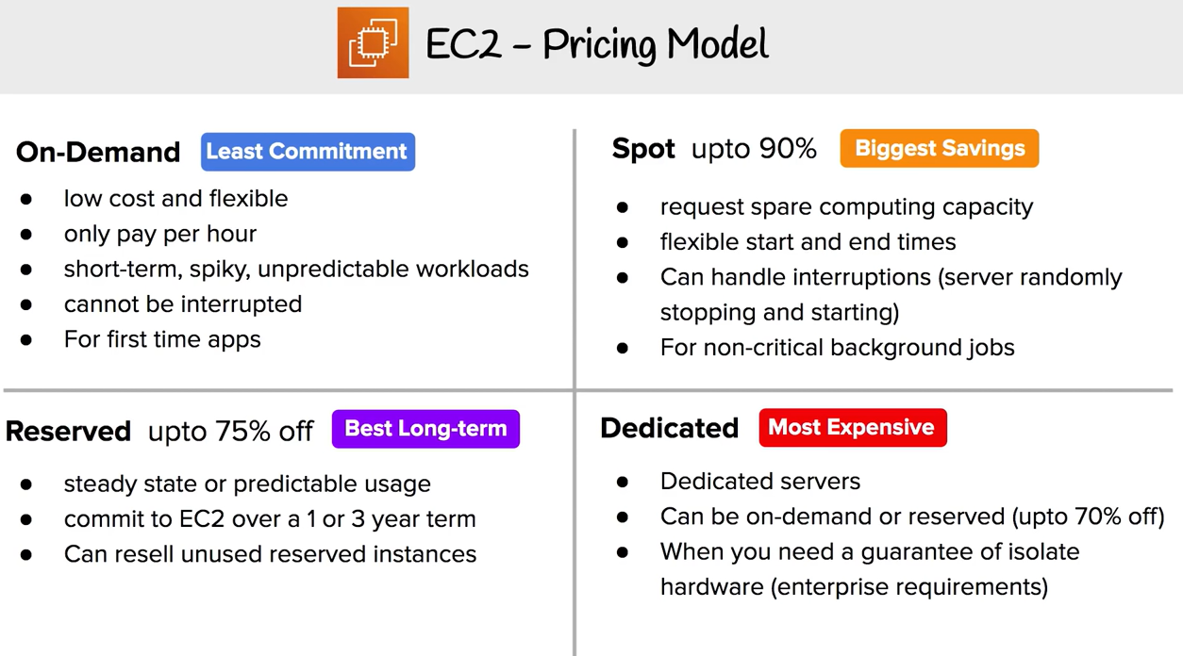

Slide 46


Slide 47
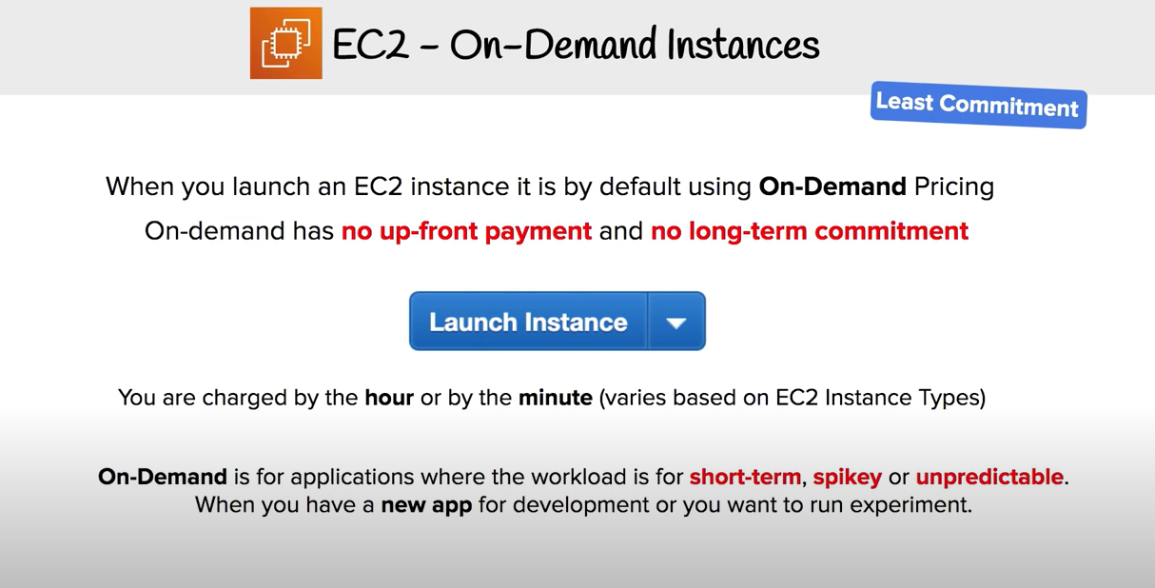

Slide 48
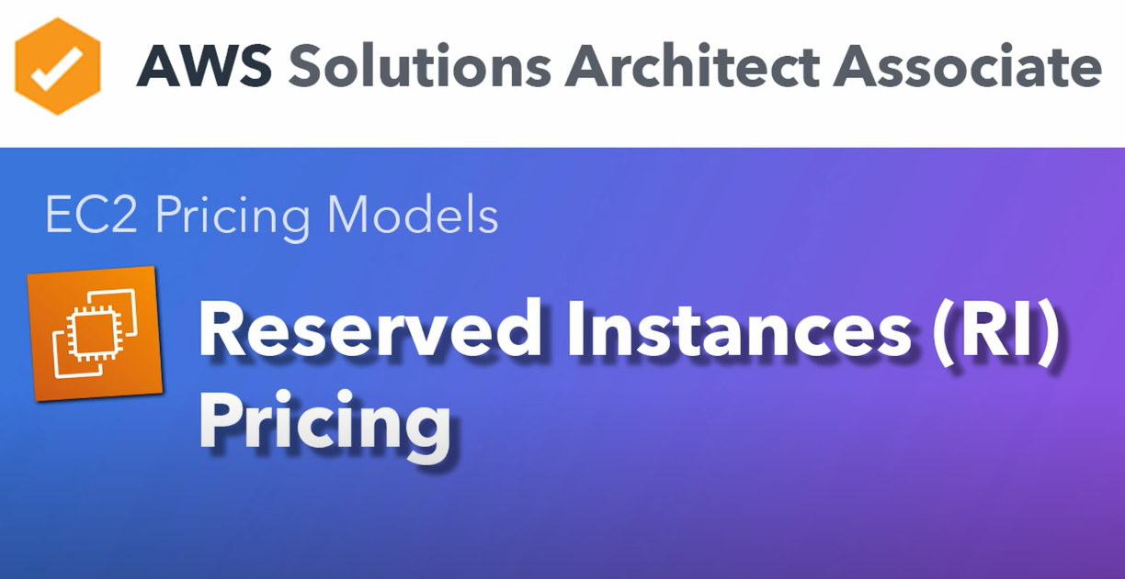

Slide 49
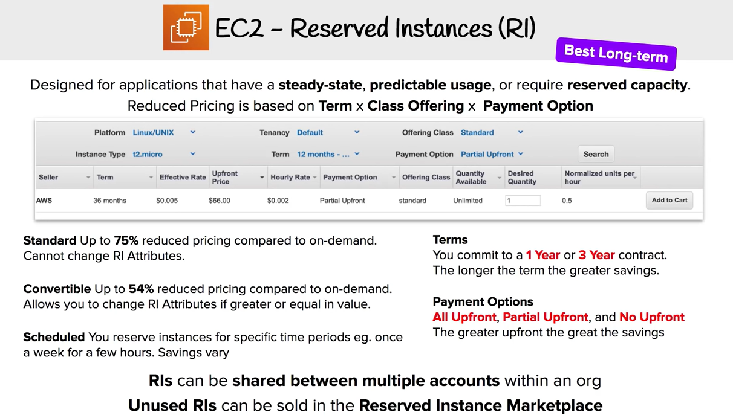

Slide 50


Slide 51
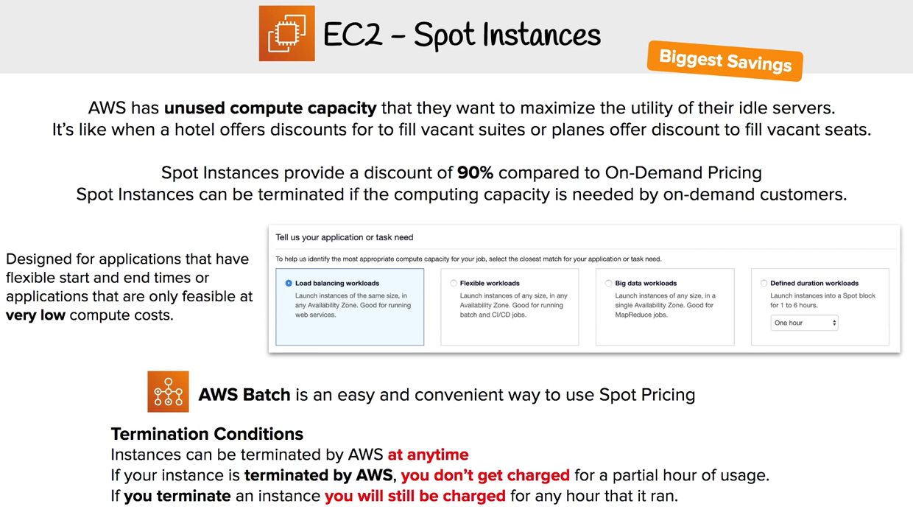

Slide 52
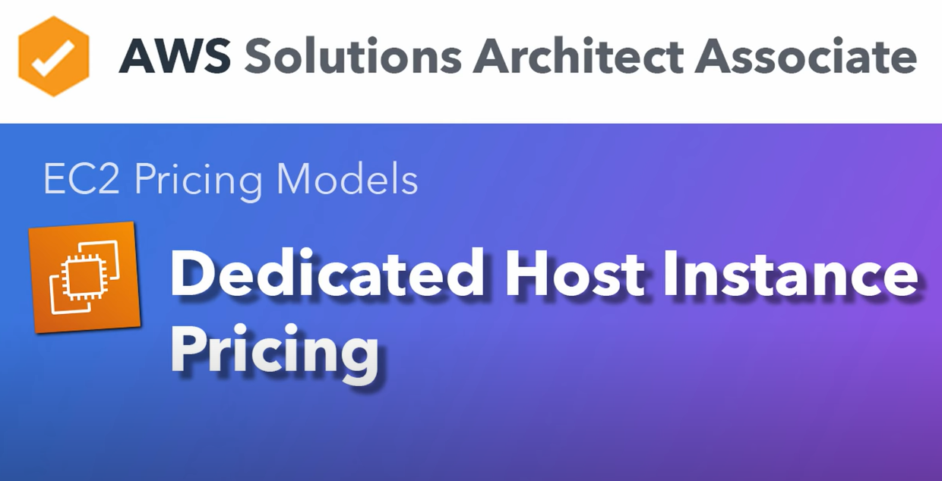

Slide 53
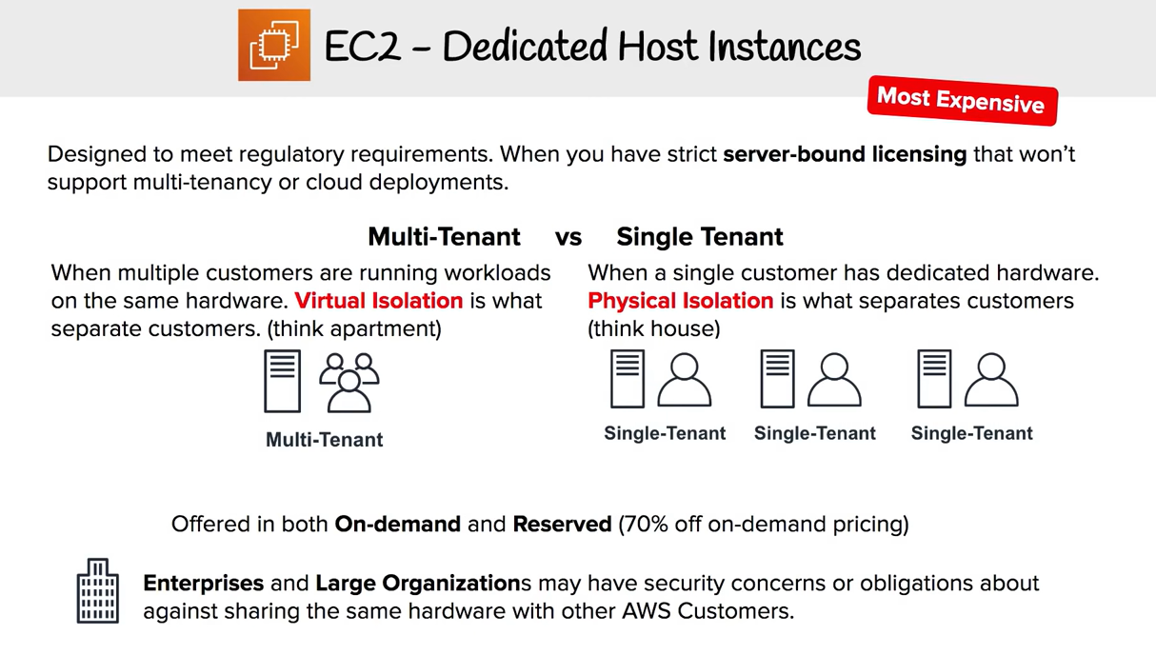

Slide 54


Slide 55
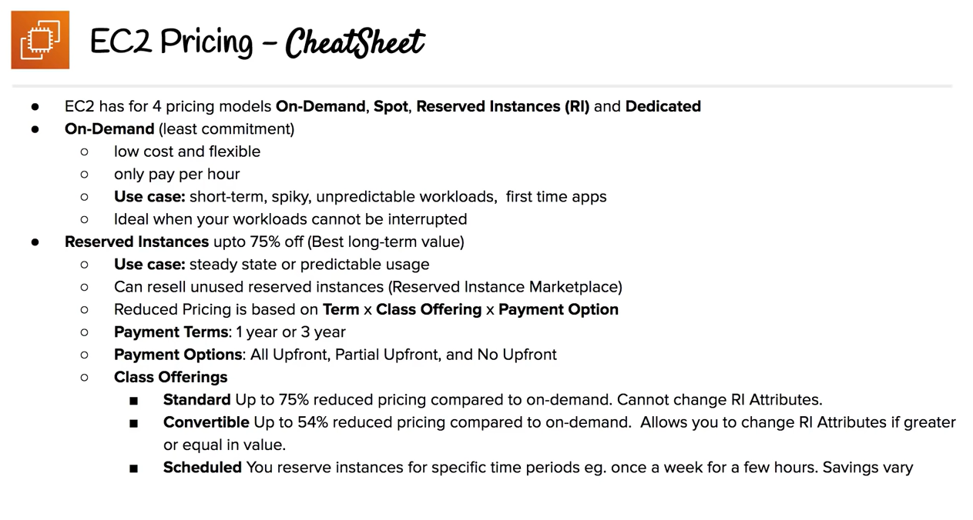

Slide 56
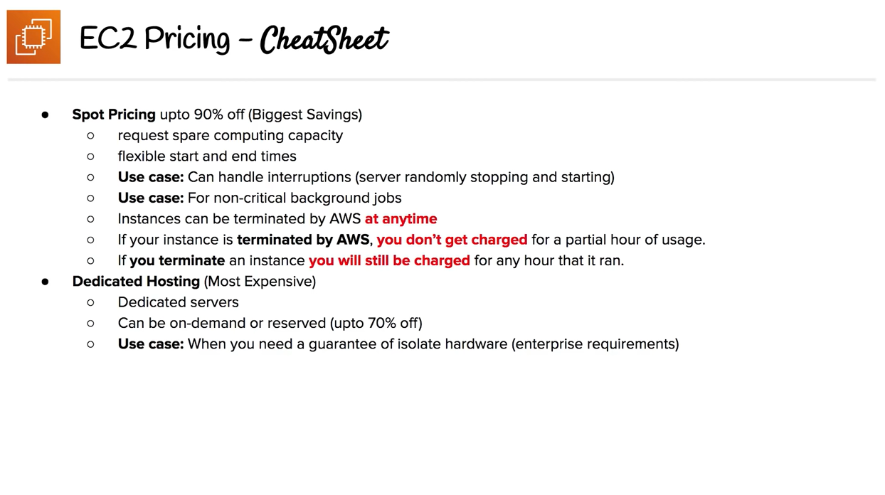

Slide 57
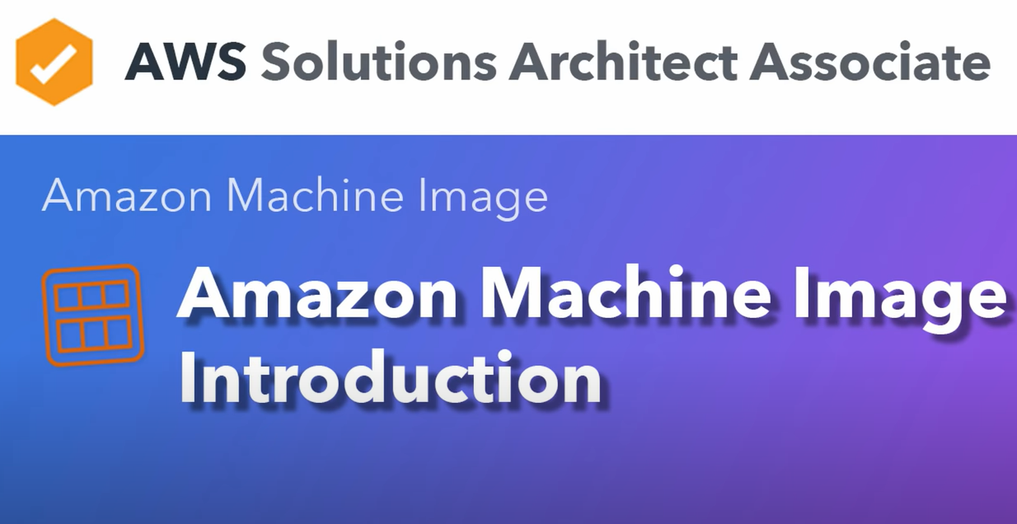

Slide 58
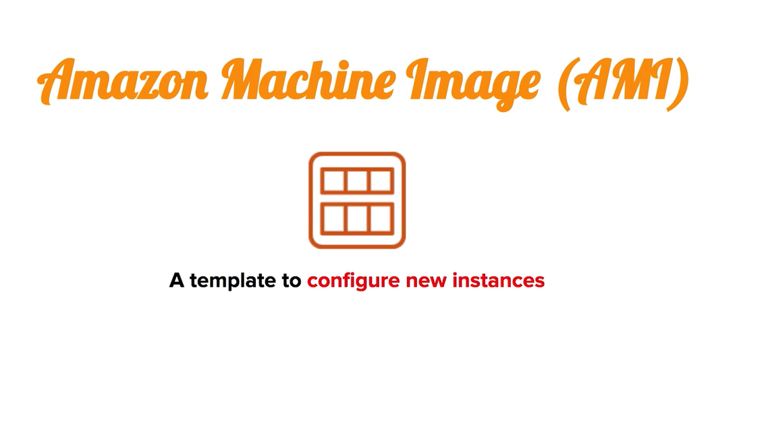

Slide 59
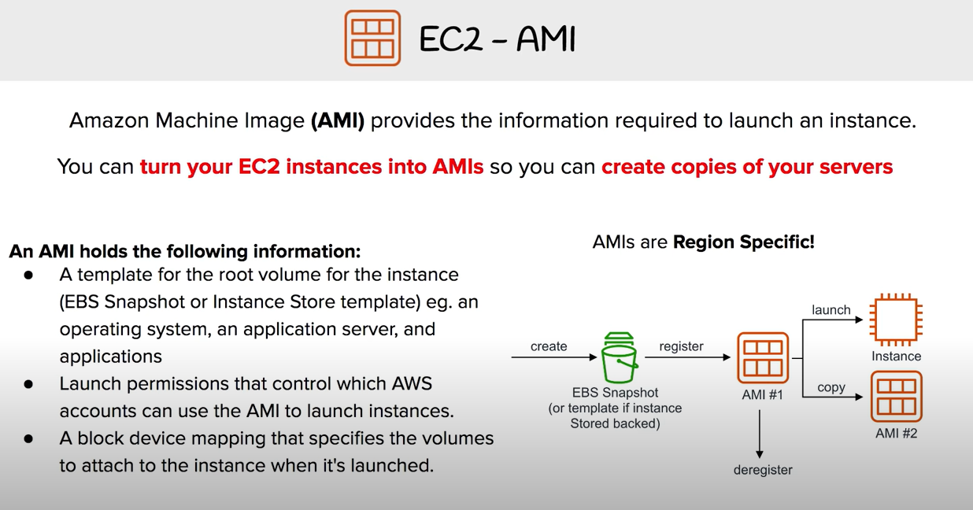

Slide 60
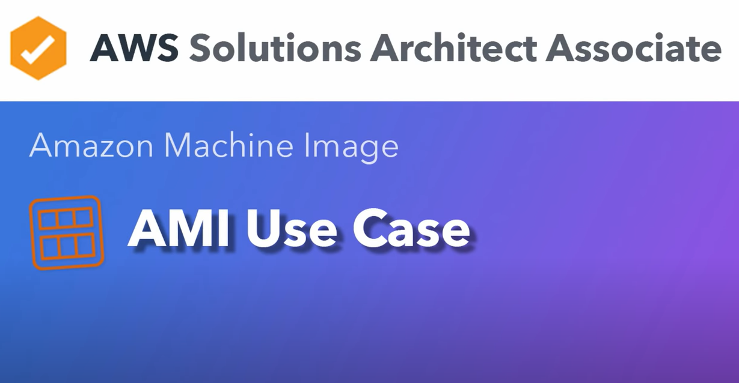

Slide 61
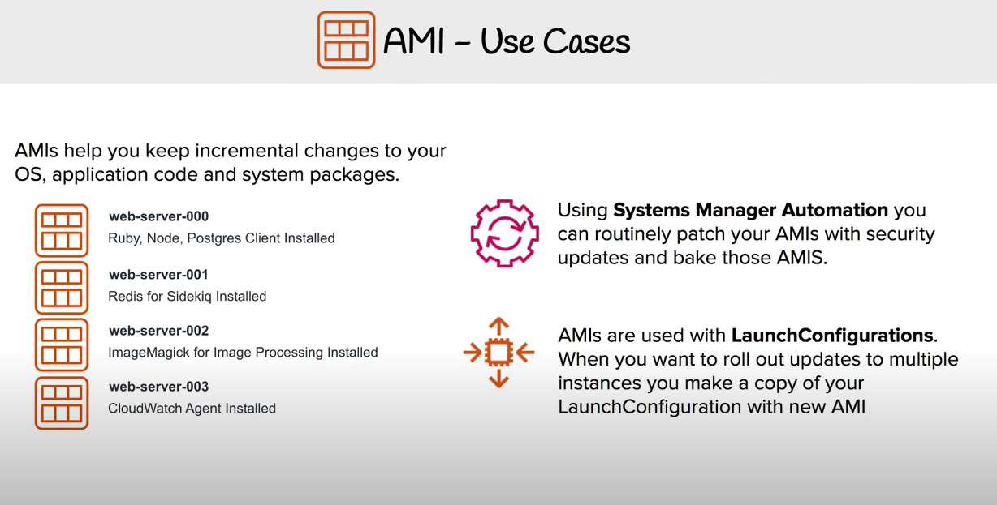

Slide 62


Slide 63
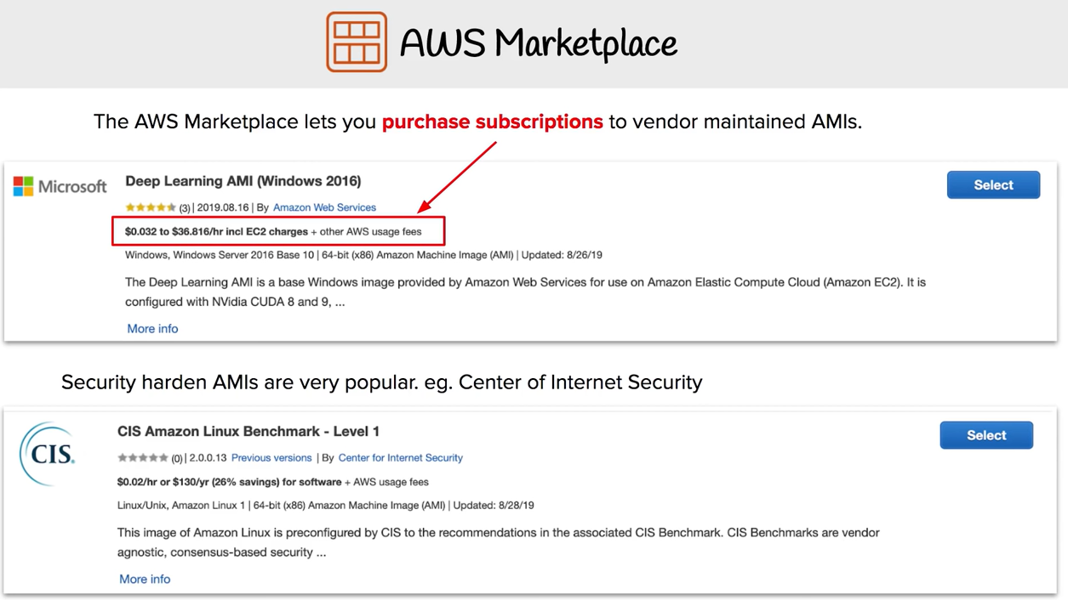

Slide 64
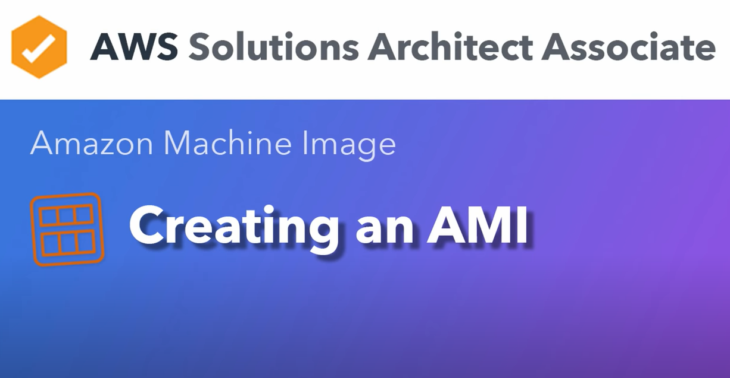

Slide 65
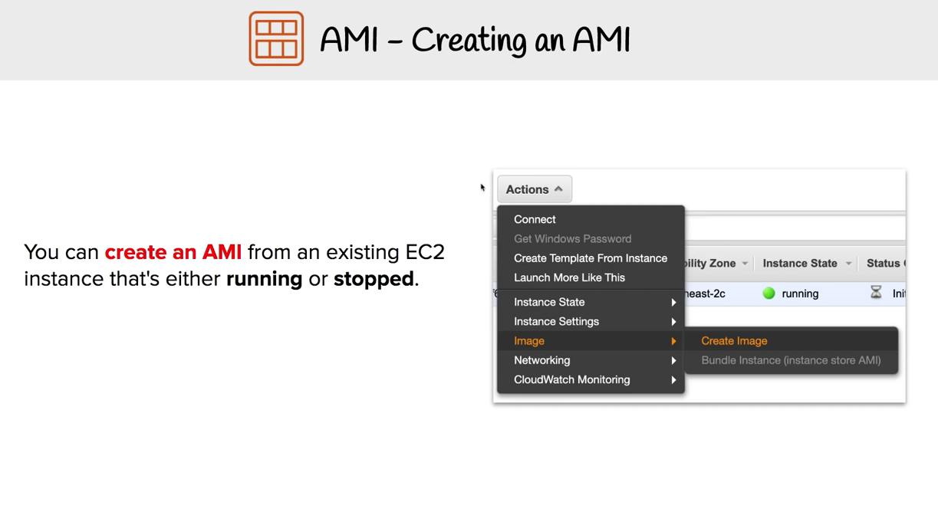

Slide 66


Slide 67


Slide 68


Slide 69


Slide 70


Slide 71


Slide 72


Slide 73
Topics
Basic tenets of AWS
Patterns and (anti-patterns) for creating scalable architectures in AWS
Bootstrapping EC2 Instances
Building with CloudFormation
Components of Auto Scaling

Slide 74


Slide 75


Slide 76


Slide 77


Slide 78


Slide 79


Slide 80


Slide 81


Slide 82


Slide 83


Slide 84


Slide 85


Slide 86


Slide 87


Slide 88


Slide 89


Slide 90


Slide 91


Slide 92


Slide 93


Slide 94


Slide 95


